Slide 1
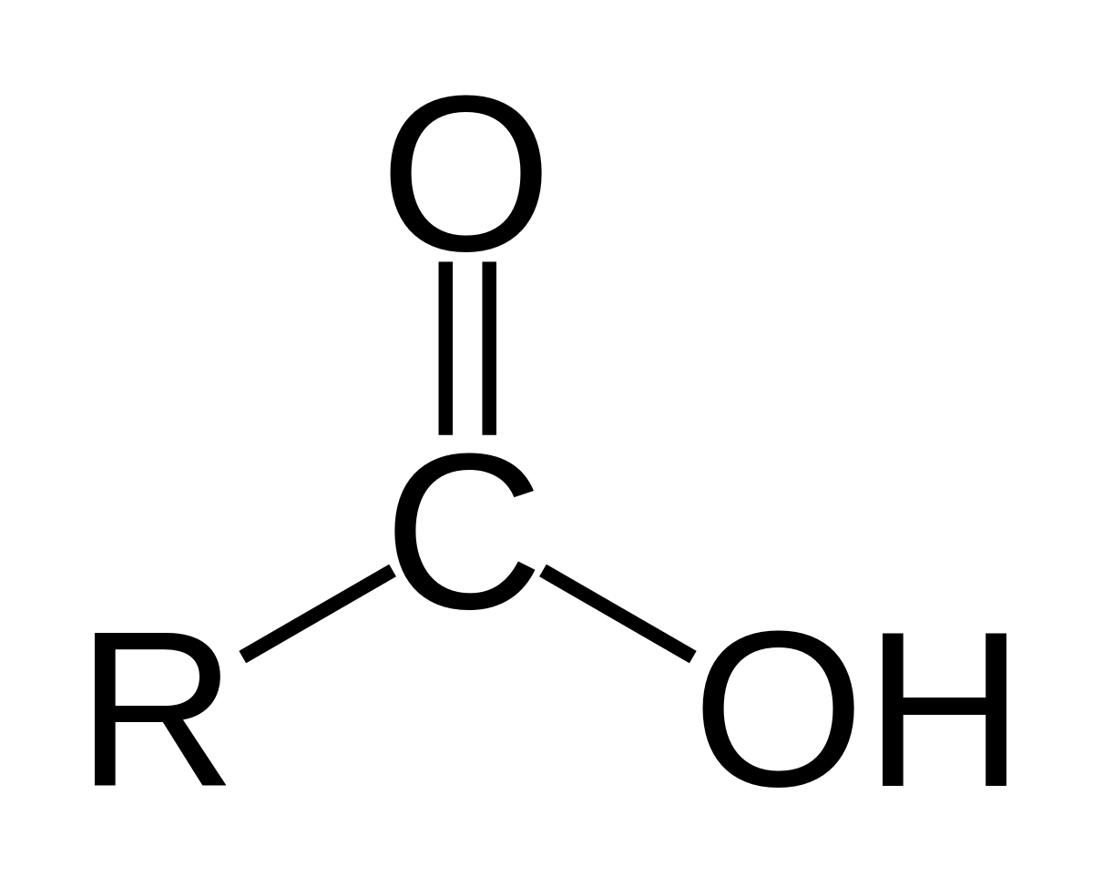
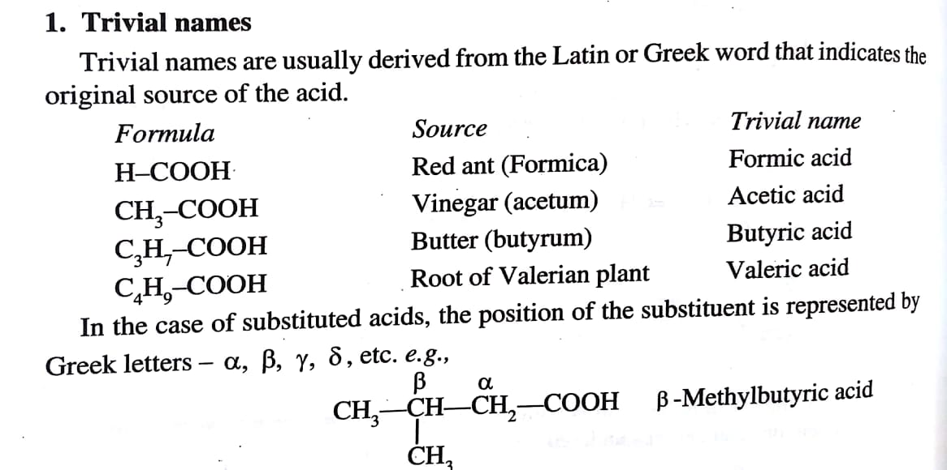
Carboxylic Acids And Sulphonic Acids
Carboxylic Acids are compounds containing carboxyl group (-COOH)
General Formula is
Long chain monocarboxylic acids are called Fatty Acids
Nomenclature
There are three ways of
naming carboxylic Acids

Slide 2

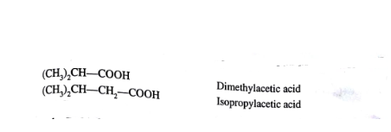
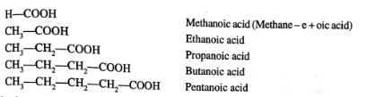
3. IUPAC names (Carboxylic Acids are named as alkanoic Acids)

Slide 3
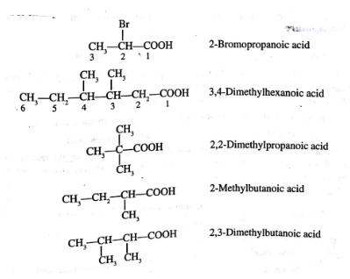
In case of substituted acid largest carbon chain including
carboxyl group is taken

Slide 4

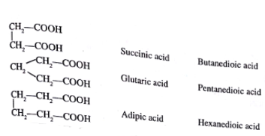
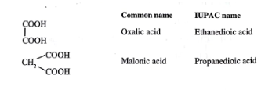
With unsaturated Acids
With compounds containing more than one carboxylic acid group

Slide 5
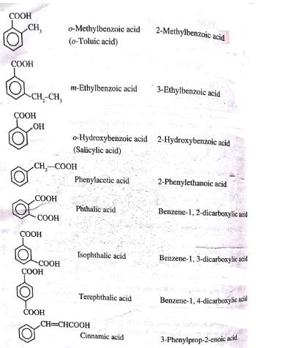

With Aromatic Acids

Slide 6

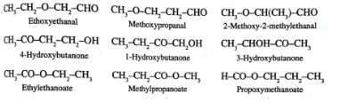
Structural Isomerism
1. Chain Isomerism
Eg: C₄H₈O₂
2. Functional Isomerism

Slide 7

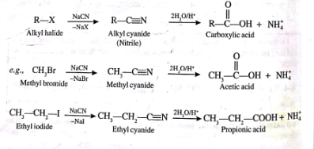
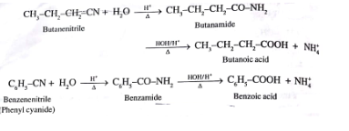
Preparation of Carboxylic Acids
1. From Nitriles (Alkyl or Aryl Cyanides)

Slide 8
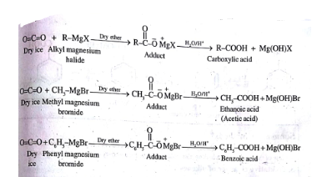

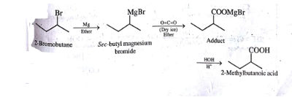
2.By Grignard Reagent

Slide 9
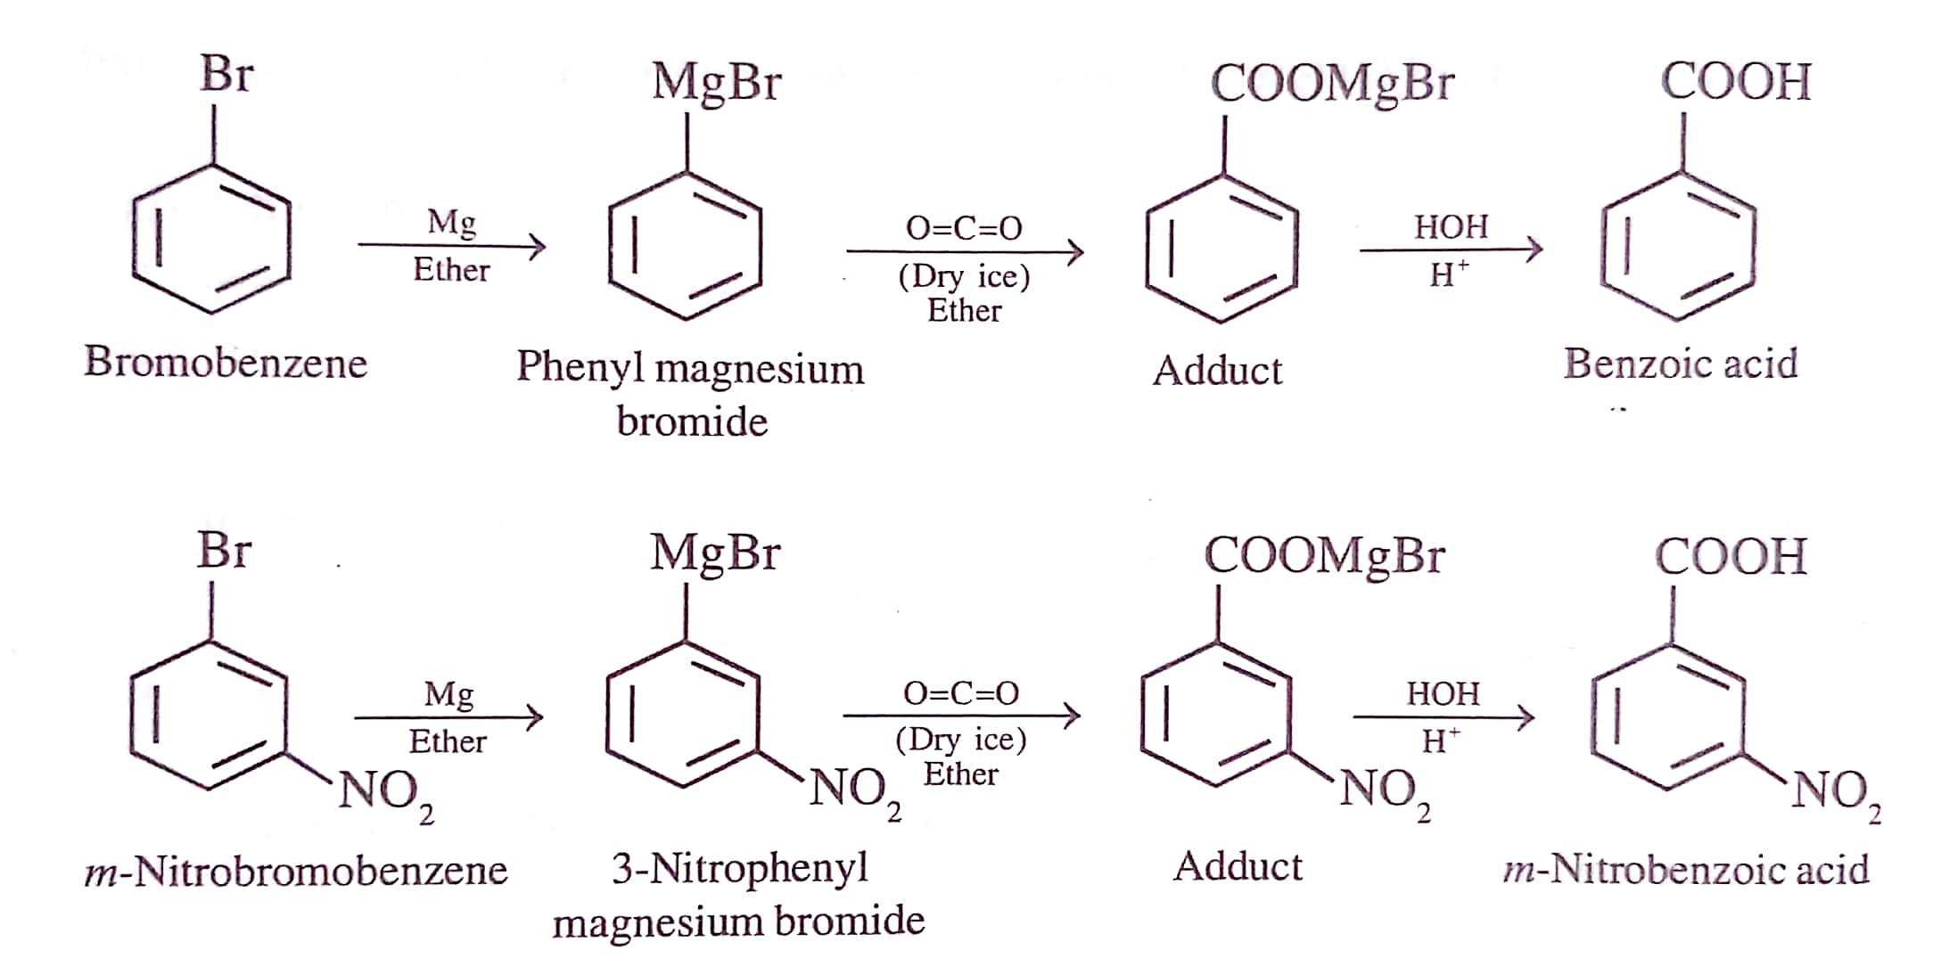

Slide 10
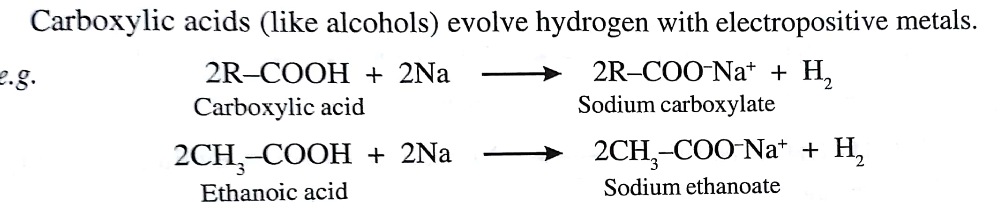
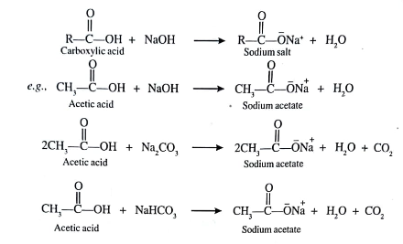
Chemical Properties of Carboxylic Acids
1. ACIDITY
a) Reactions with Metals
b) Reaction with bases

Slide 11
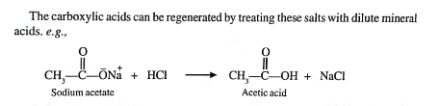


c) Dissociation equilibrium
Carboxylic Acids dissociate in water to give :
Smaller the P^{ka} Value of an acid
the stronger the acid

Slide 12

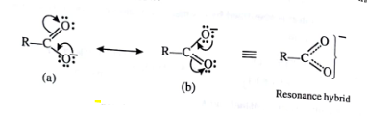
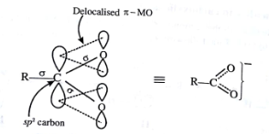
Origin of acidity in carboxylic Acids

Slide 13
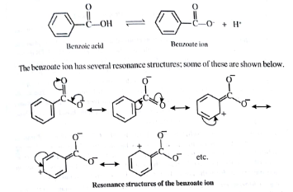
Acidity of Aromatic Carboxylic Acids
Due to greater resonance stabilization, Aromatic carboxylic acids are stronger
than Aliphatic carboxylic Acids

Slide 14
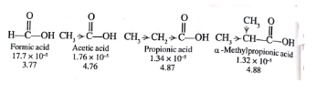

Effect of substituents on Acidity of Aliphatic Carboxylic Acids
1. Electron releasing substituents decreases acidity
Hence Formic Acid is more acidic than Methyl propionic Acid
2. Electron withdrawing substituents increases acidity (Cl, Br, F, OH, CN)

Slide 15
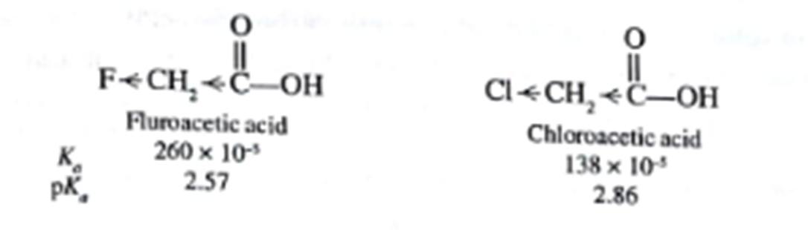
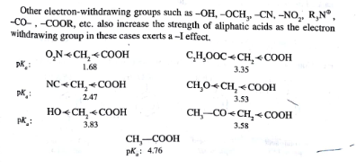
a) Strength of electron withdrawing substituents

Slide 16


b) No of electron withdrawing substituents
c) Position of electron withdrawing substituents
d) Presence of multiple bonds adjacent to carboxyl groups
(increases acidity)
CH2 = CH- COOH > CH3 - CH2 - COOH
due to greater electronegativity of SP2 hybridized carbon than SP3
Resonance stabilization of carboxylate ion extending to the double bond

Slide 17

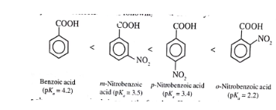
Effect of substituents on the acidity of aromatic carboxylic acids
All ortho substituents are acid strengthening – Ortho Effect
( both electron releasing and electron withdrawing )
Electron withdrawing substituents
It increases the acidity when present in meta or para position and the effect will be more at para position

Slide 18
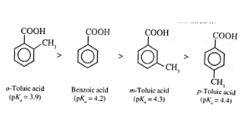
Electron releasing substituents
It decreases the acidity when present in meta or para position as it intensify the negative charge of the carboxylate ion.

Slide 19
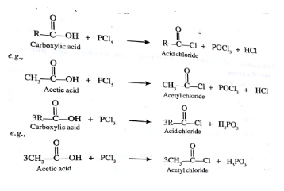
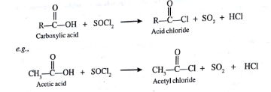
Preparation of Acid Derivatives
1. Formation of Acid Chloride
Carboxylic acids react with PCl3, PCl5 or SOCl2 to give
Acid Chloride (Acetyl Chloride )

Slide 20
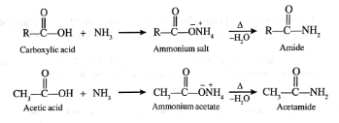

2. Formation of amides
3. Formation of Esters

Slide 21
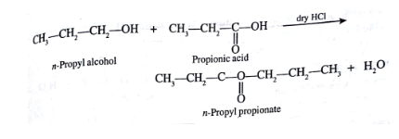
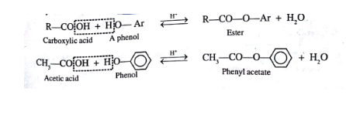
Fisher Esterification (Fisher Speier Esterification)
Carboxylic acid reacts with phenol too but the reaction is low

Slide 22
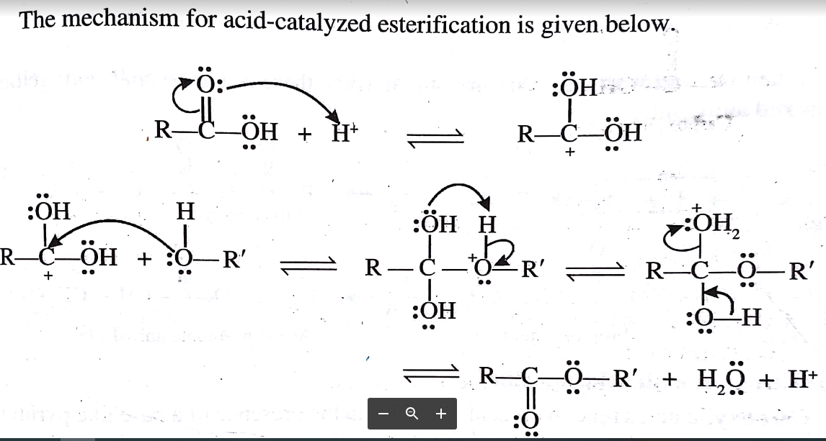
Mechanism of Fisher Esterification

Slide 23
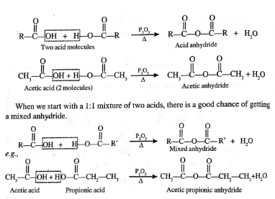
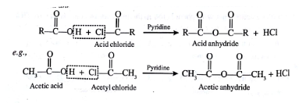
4.Formation of Anhydrides
a) By dehydration by P₂O₅
b) With Acid chloride in presence of Pyridine

Slide 24
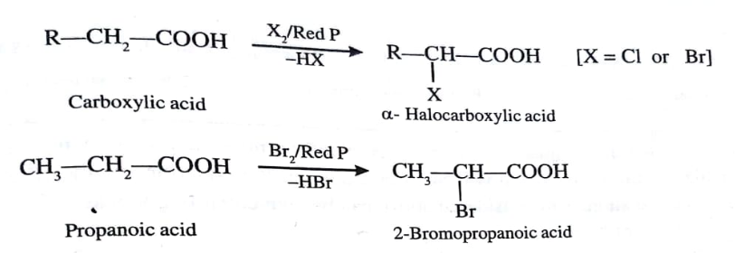
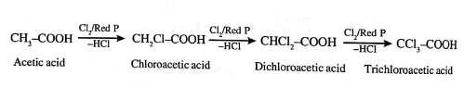
Hell Volhard Zelinsky Reaction (HVZ Reaction)
Carboxylic Acids having α-Hydrogen atoms
Reagent : Chlorine/ Bromine in presence of Red Phosphorus

Slide 25
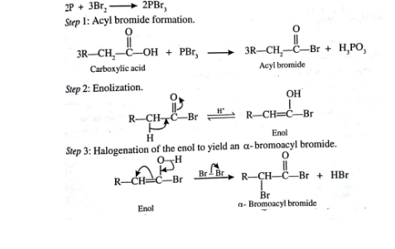
Mechanism

Slide 26
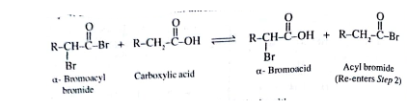
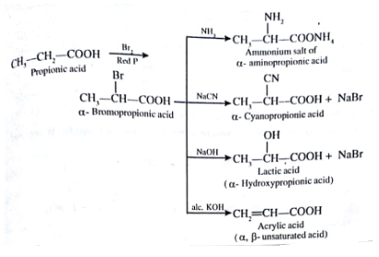
Step 4 :Exchange reaction with unreacted Acid
Applications
α-Halogenated Acids are convenient starting material for preparing other α - substituted acids

Slide 27

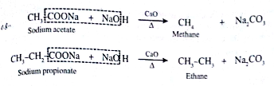


Decarboxylation
1. With Soda lime (3:1 mixture of Sodium Hydroxide and Calcium Oxide)

Slide 28


Mechanism
1.Decarboxylation of carboxylate anion
2. Decarboxylation of free acid

Slide 29


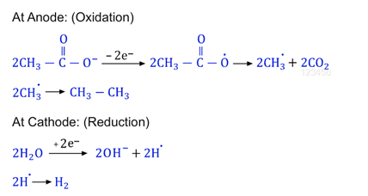
Kolbe’s Electrolysis
Mechanism

Slide 30
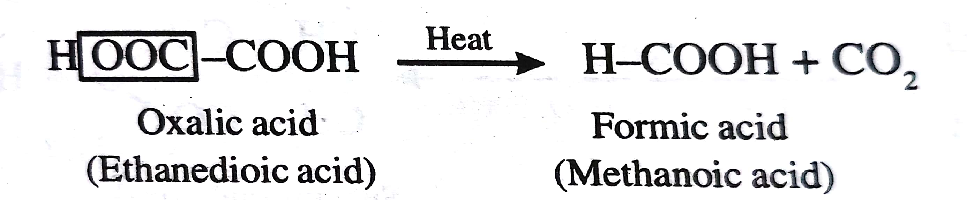
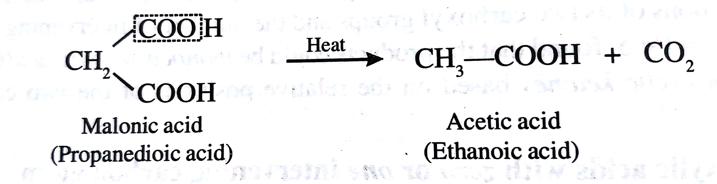
Action of heat on Dicarboxylic Acid (Blanc’s Rule)
Dicarboxylic Acids in which carboxyl group separated by zero or
one carbon atom

Slide 31
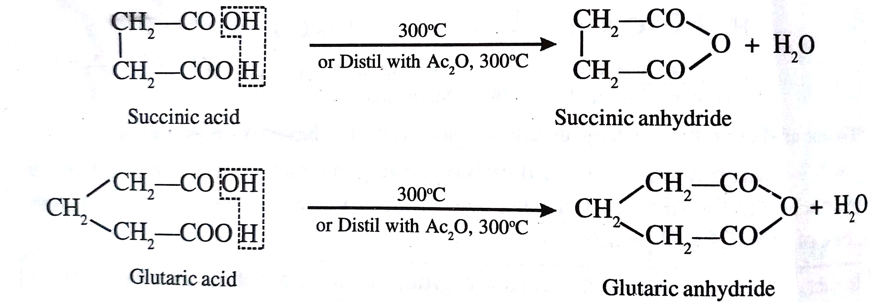
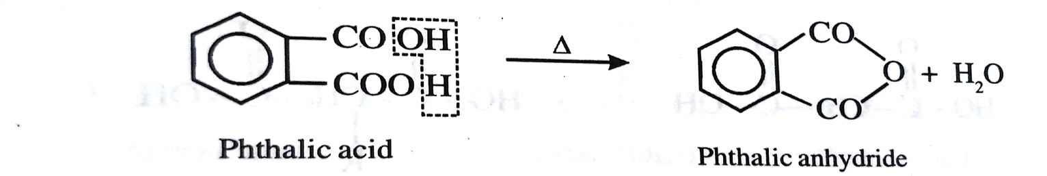
2. Dicarboxylic Acids in which carboxyl group separated by two or
three carbon atom

Slide 32
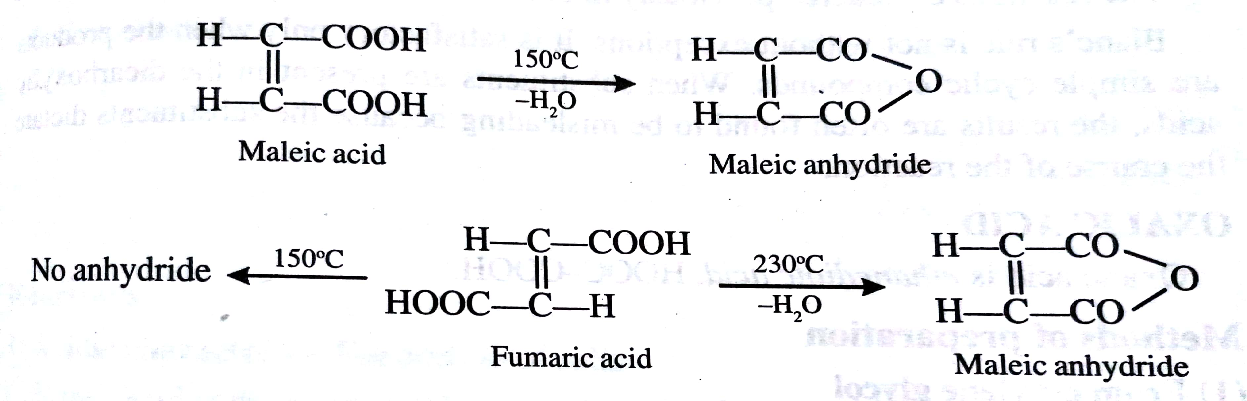
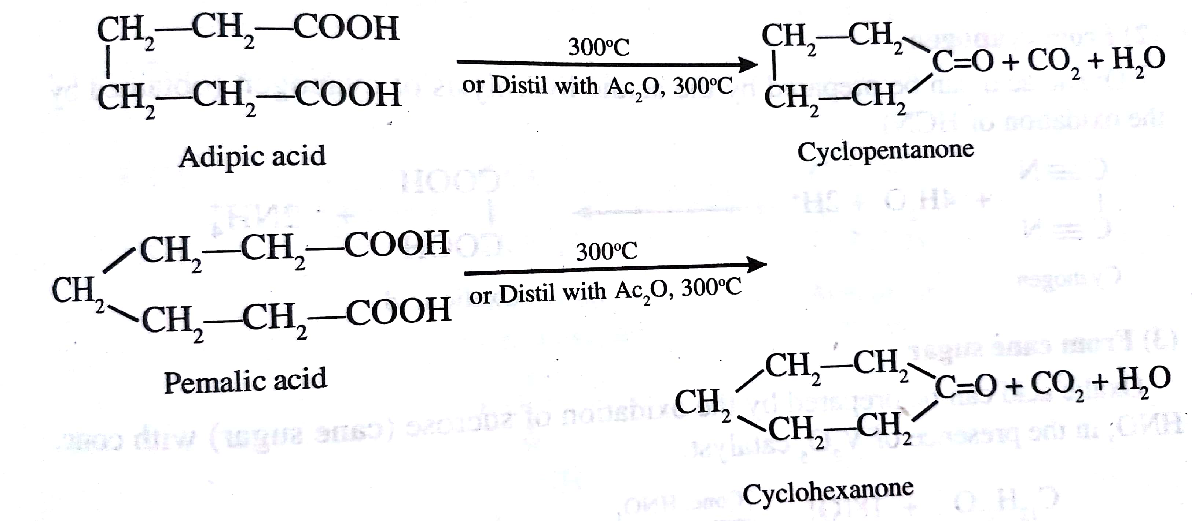
3. Dicarboxylic Acids in which carboxyl group separated by four or five carbon atoms

